Slide 1
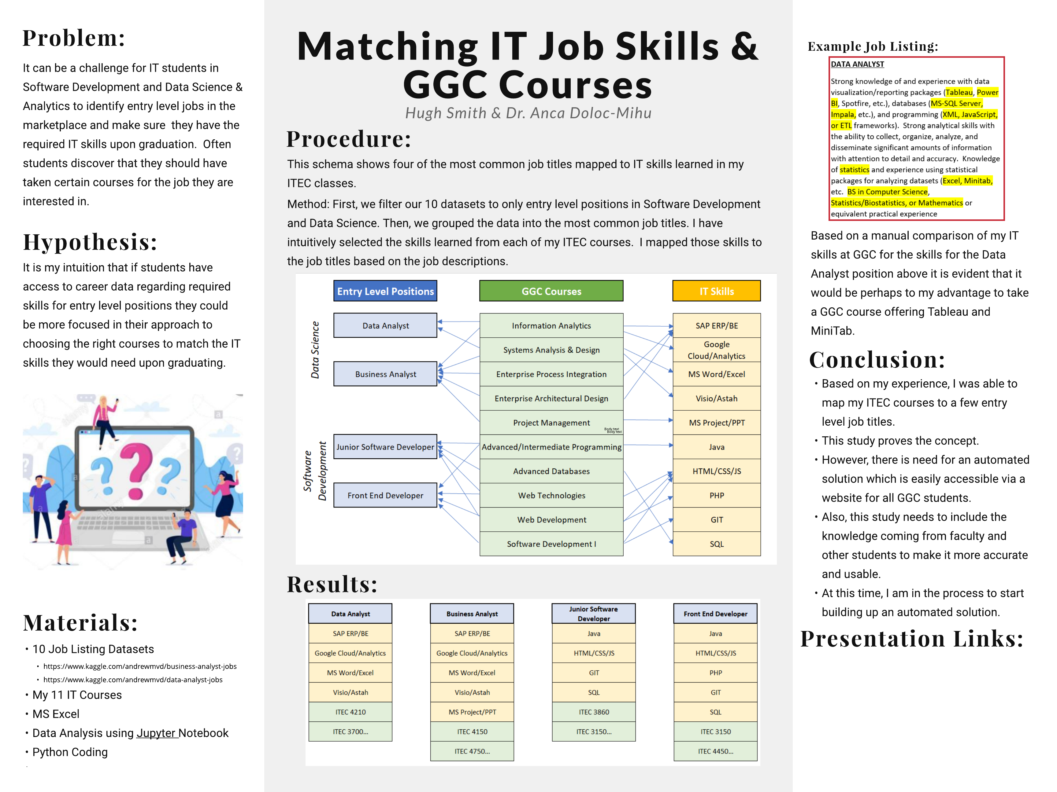
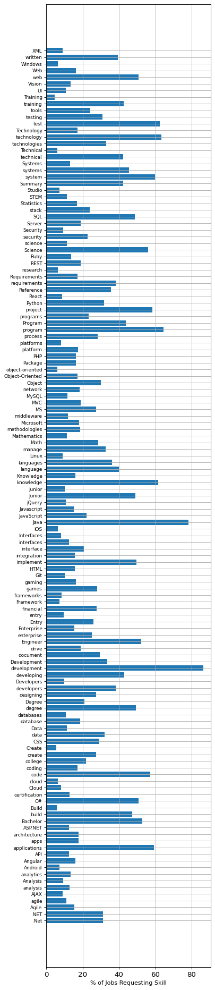
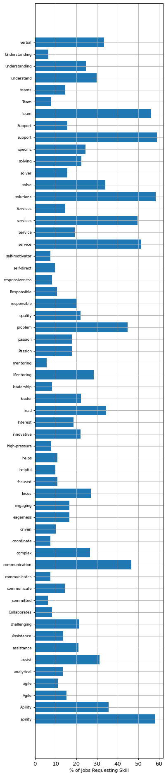
Statistical Sample:
Skills for “Entry Level Software Developers”
719 Job Listings : Jan-Jul 2019
Hard Skills
Soft Skills
Video: Hard Skills vs Soft Skills
Presentation Survey

